Slide 1
International Master in Virtual Reality Production
Suzana Žilič Fišer suzana.zilicfiser@um.si Jani Pavlič jani.pavlic@um.si Matevž Pucer matevz.pucer@um.si
UM - University of Maribor
Faculty of Electrical Engineering and Computer Science Institute for Media Communications

Slide 2
Prof. Dr. Suzana Žilič Fišer
Associate professor and a Head of Institute for Media Communications at the University of Maribor
Study
University of Ljubljana
CEU in Budapest
University of Westminster London
PCMLP in Oxford
Research focus: communication, culture, media
Publications:
Books: Public service broadcasting on the market (FDV), Successful Television management (Peter Lang Publishing)
Chapters in different books by Palgrave MacMillan, IGI Global, Routledge communication series
Others:
Appointed by the Ministry of culture of Republic of Slovenia as a member of the Media committee supporting pluralism in media environment.
President of the Council of Slovene National Theatre Maribor as the biggest cultural institution in Slovenia
From 2011 to 2013 - the Director General of the European Capital of Culture
From 2013 until 2020 - designated by European Commission as a member of the selection and monitoring panel for the European Capital of Culture.

Slide 3
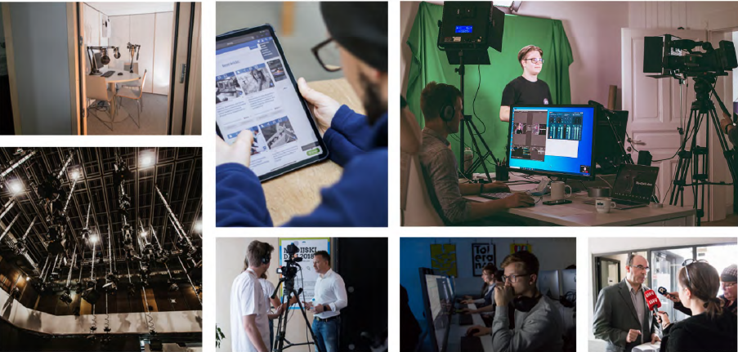
Media Communications

Slide 4
Lectures Prof. Dr. Suzana Žilič Fišer
Practical courses Jani Pavlič and Matevž Pucer
Undergraduate
Introduction to Communication
Preparing Media Contents
Organization of Audiovisual Production
Media and Democracy
Performing in Media
Postgraduate - master
Organization of Television Production
Practical course: Writing for Electronic Media
TV programs
Undergraduate
Data communication
AV Technologies
Photography
Audiovisual production techniques
Electronic media production
Postgraduate - master
Screenwriting and preproduction
TV and video production
Web Multimedia content
Technologies in media production

Slide 5
Projects – last 4 years
Name of EU programme | Name of the project
Horizon 2020 | Demonstration of intelligent decision support for pandemic crisis prediction and management within and across European borders – STAMINA
Horizon 2020 | Cyber Security Network of Competence Centres for Europe – CyberSec4Europe
Horizon 2020 | Cyber security cOmpeteNce fOr Research anD lnnovation - CONCORDIA
Horizon 2020 | Centre of Excellence - InnoRenew CoE
Horizon 2020 | Modular Approach to Hybrid Electric Propulsion Architecture – MAHEPA
Horizon 2020 | Patients-centered SurvivorShIp care plan after Cancer treatments based on Big Data and Artificial Intelligence technologies - PERSIST
ARPAF | Smart SME's
Interreg Alpine Space | Smart digital transformation of villages in the Alpine Space – Smart Villages
Interreg Slovenia - Avstria | Ecotours for e-carriages: promoting nature-friendly cross-border sustainable tourism through innovative tourism products – Ecarriage
Interreg Slovenia - Avstria | Public warnings - reducing rain and snowfall related risks – CROSSRISK
Erasmus+ | EUROPEAN NETWORK FOR ACADEMIC INTEGRITY – ENAI
Erasmus+ | Computers, Cognition and Communication in Control: A strategIc partnership – Co4AIR
Erasmus+ | Collaborative learning platform with integrated remote laboratory environment in VET – CORELA
Erasmus+ | Certified Digital Accessibility Training – DigitalAccessibility
Erasmus+ | Reforming doctoral studies in Montenegro and Albania – good practice paradigm –MARDS
Erasmus+ | Outplacement Support for Doctorates in Emerging Areas – OUTDOC
Erasmus+ | Progression of Accessibility Centres in higher Education for Students with disabilities in North Africa – PACES
Erasmus+ | Network of Helath Science Innovation Incubation Programs – NetHIIP
Erasmus+ | Alliance for Batteries Training and Skills - ALBATTS

Slide 6
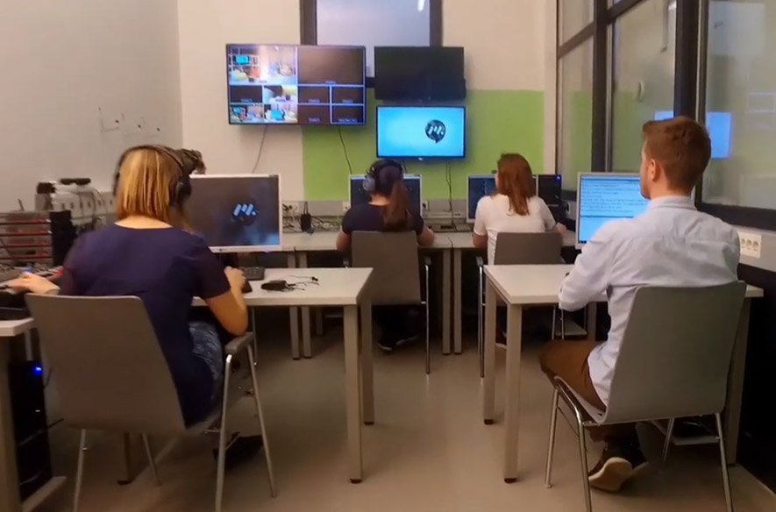
Media production @ UM
Practically oriented, interdisciplinary skills
RTV studio with control room

Slide 7
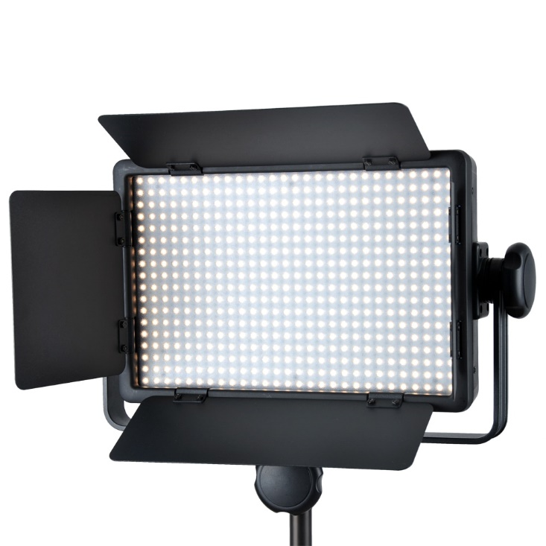
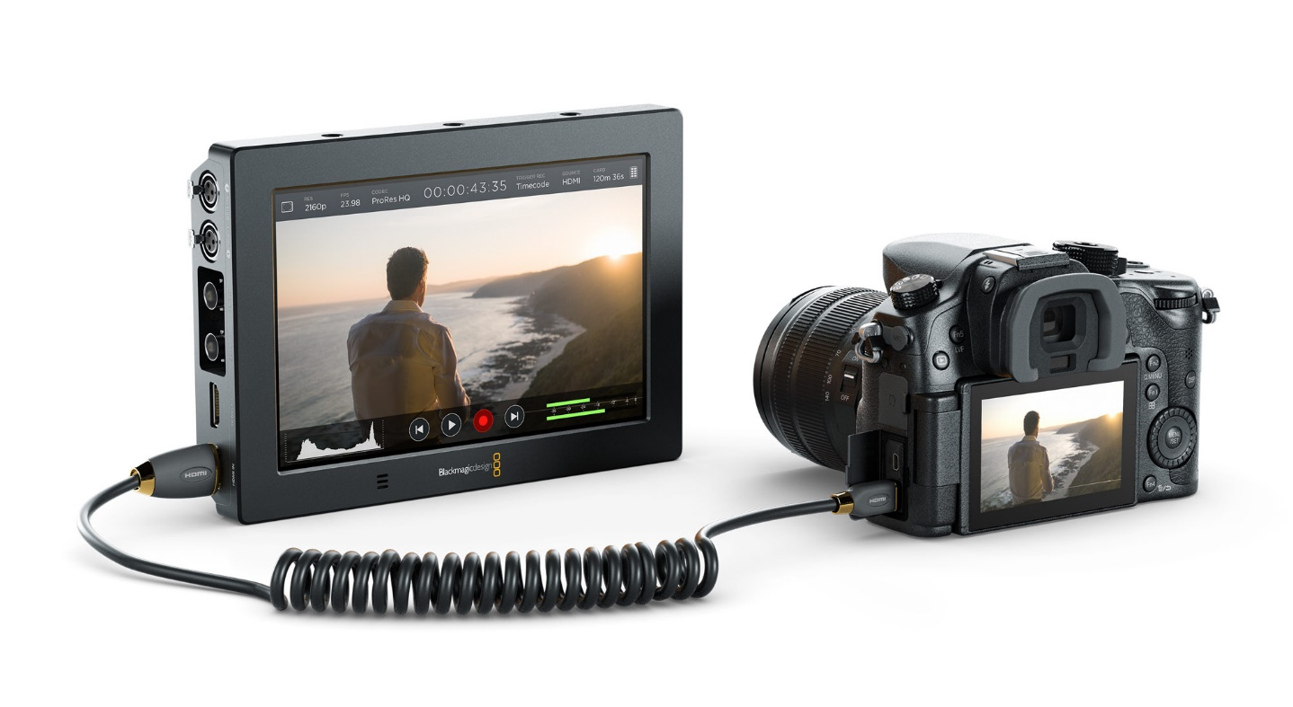
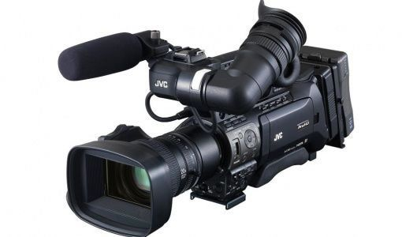
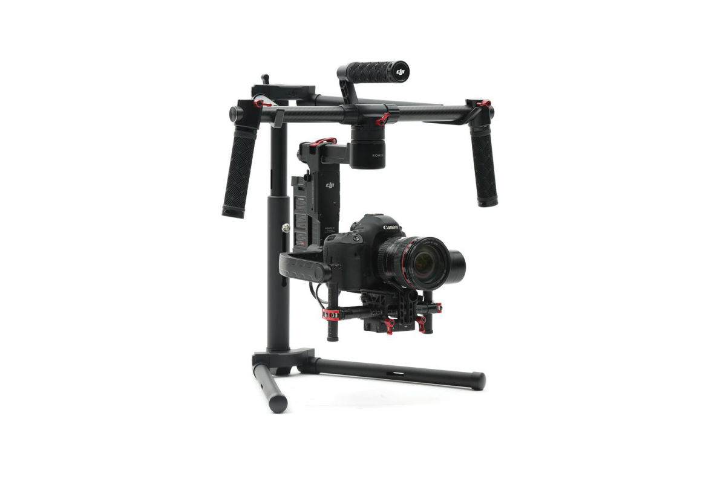
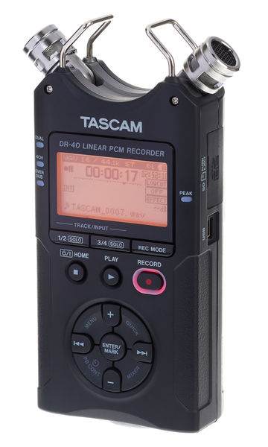
Equipment and technologies

Slide 8
Virtual reality – 3 DoF
Filming in VR
Storytelling
News reporting in 360°
Human-Computer Interaction
Directing in VR
Post-production

Slide 9
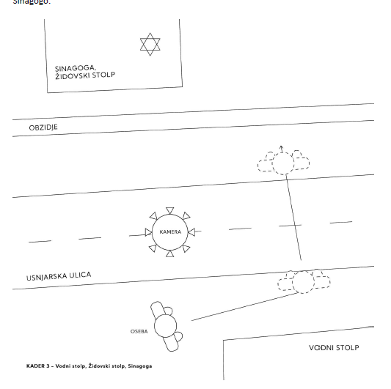
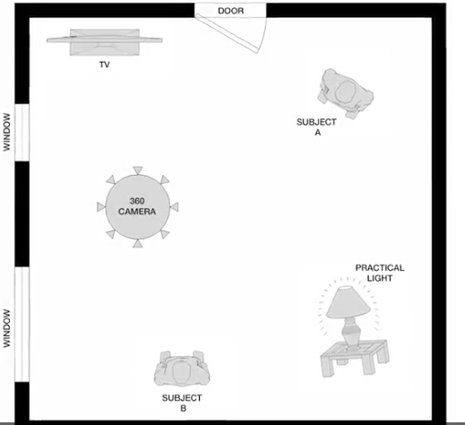

Slide 10
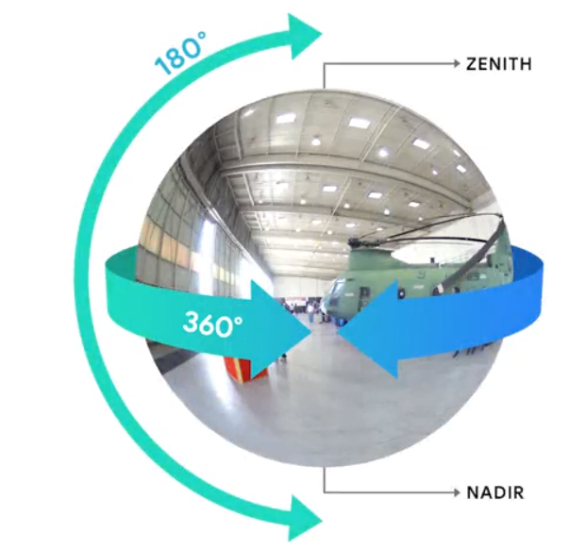
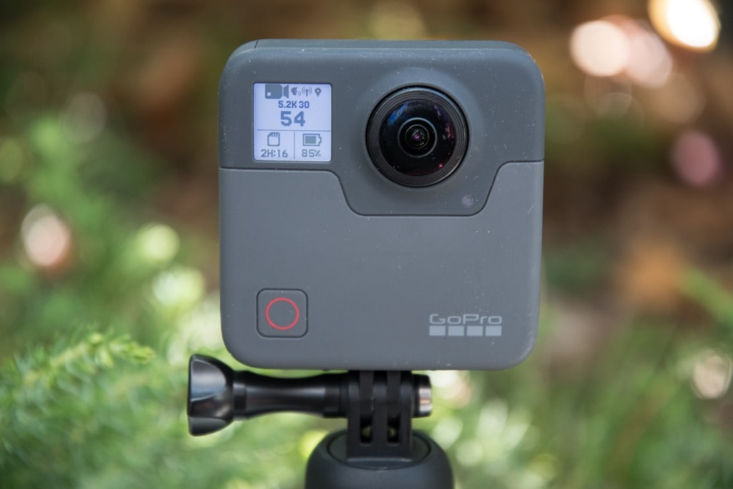
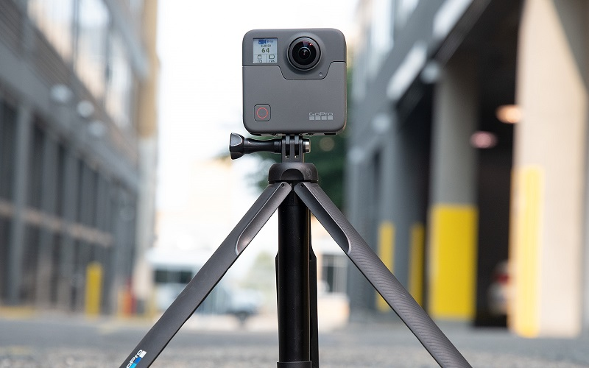
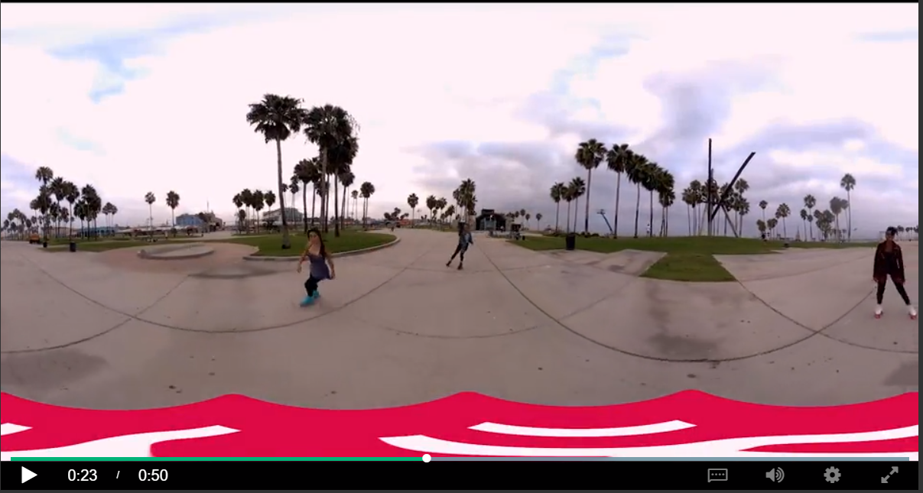

Slide 11
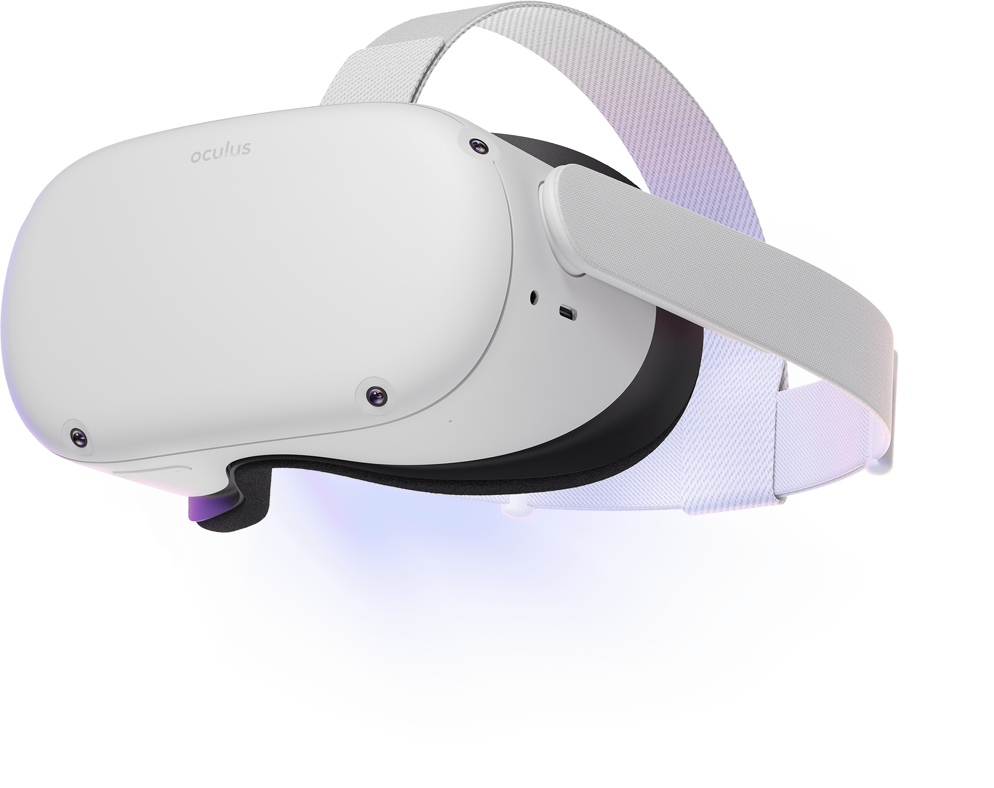
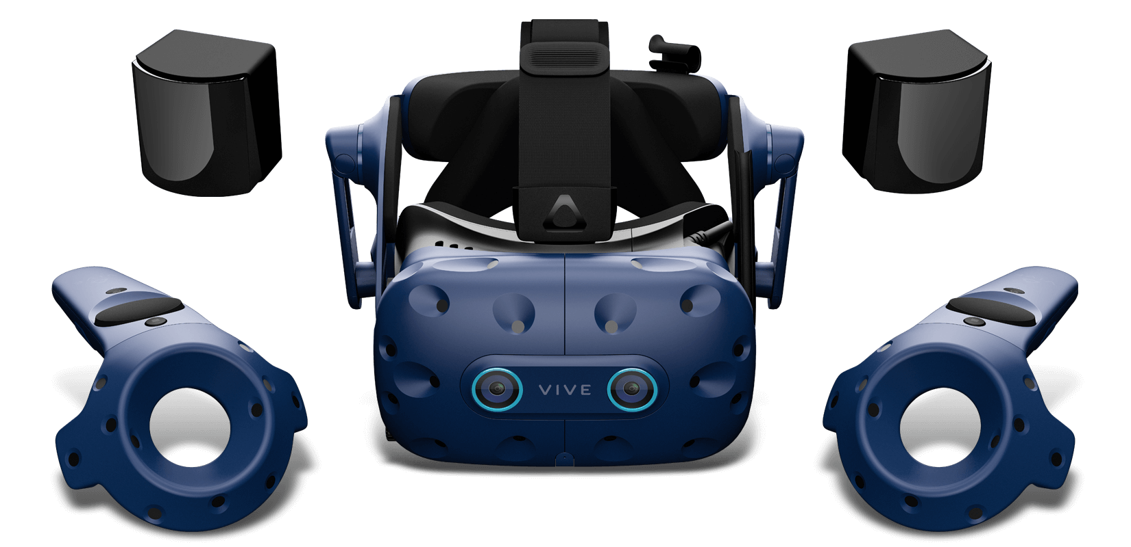
Head-mounted displays

Slide 12
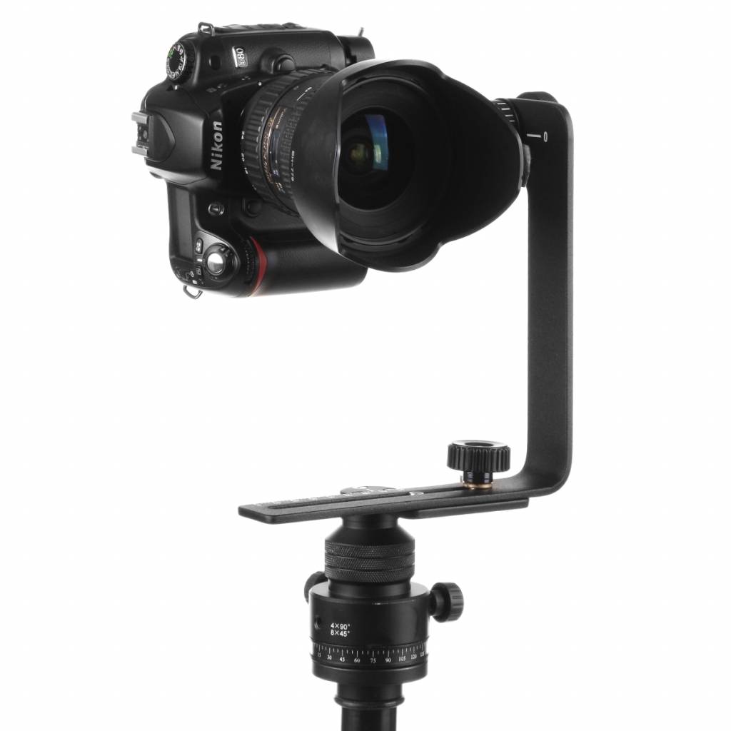
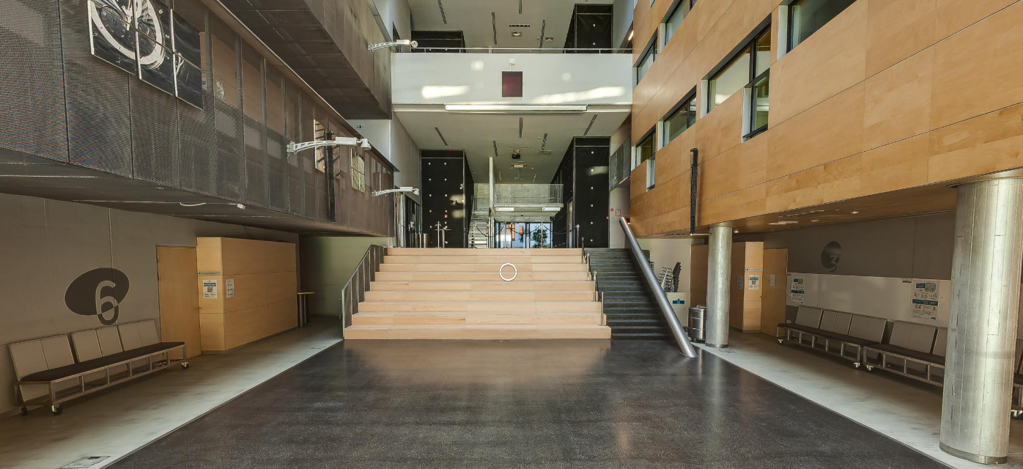
Virtual Tour
https://feri.um.si/virtualni-sprehod/

