Slide 1

association for digitization and informatisation of cultural heritage

Slide 2

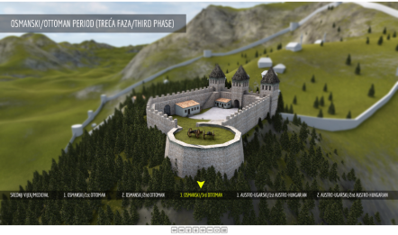
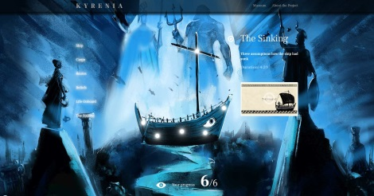
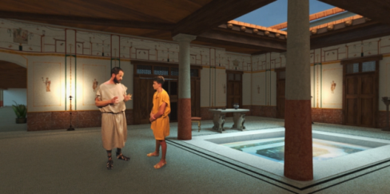
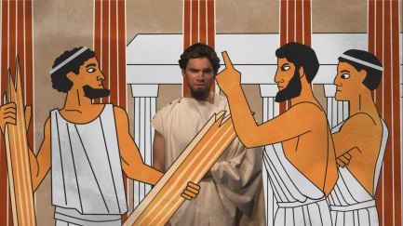
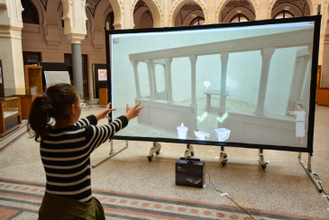
Who are we?
Research lab Sarajvo Graphics Group established in 2004.
Areas of research: Computer graphic, computer animation, multimedia, interactive digital storytelling, virtual and extender reality.
2006. Digital Media Center was founded on Sarajevo School of Science and Technology
Members: Experts from IT, visual art, musicians, historians, archaeologists, writers
2010. se founded association for digitization and informatisation of cultural heritage DIGI.BA
Projects:
  Virtual presentations of cultural heritage
  Virtual museums
  Virtual and extended reality
  360 video

Slide 3
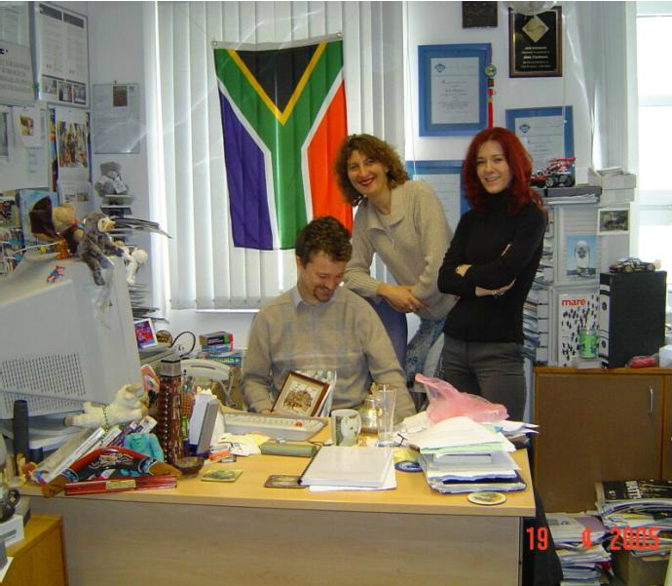
How it started?
Sarajevo Graphics Group
From 2004.
Mr Selma Rizvić
Aida Sadžak
Prof. Alan Chalmers
Bristol University, UK

Slide 4


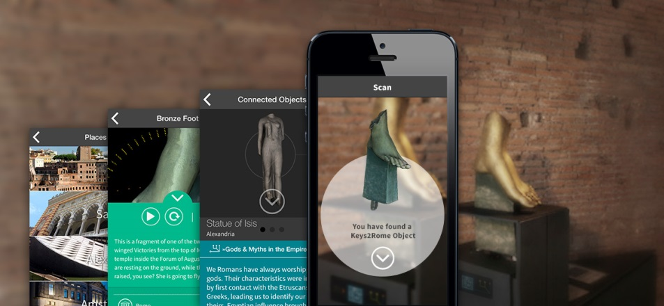
EU FP7 NoE V-MusT.net, 2011-2015
Virtual Museum Transnational Network
ETF Sarajevo partner
18 institutions from 13 countries
Virtual reconstruction of villa and thermal baths in Ilidža and Roman Basilica in Mostar
Presentation Keys of Rome (Rim, Amsterdam, Aleksandrija, Sarajevo) 2014

Slide 5
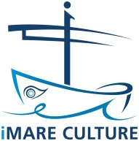

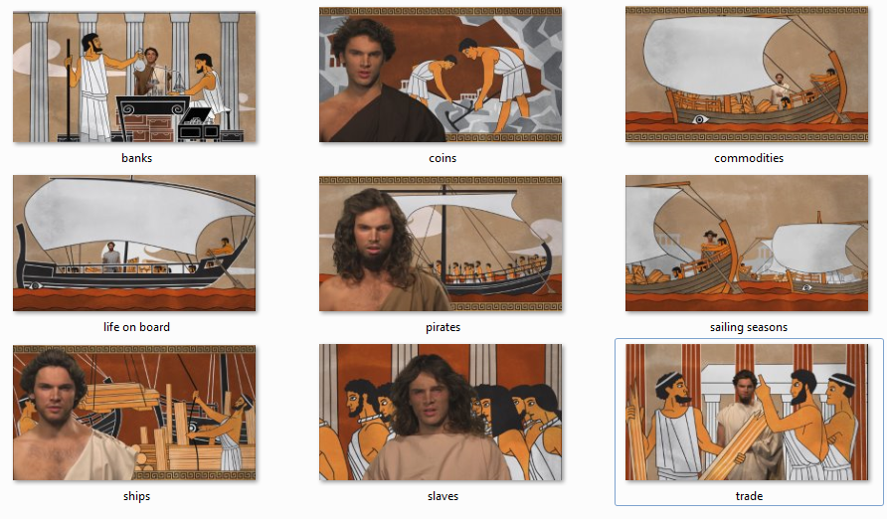
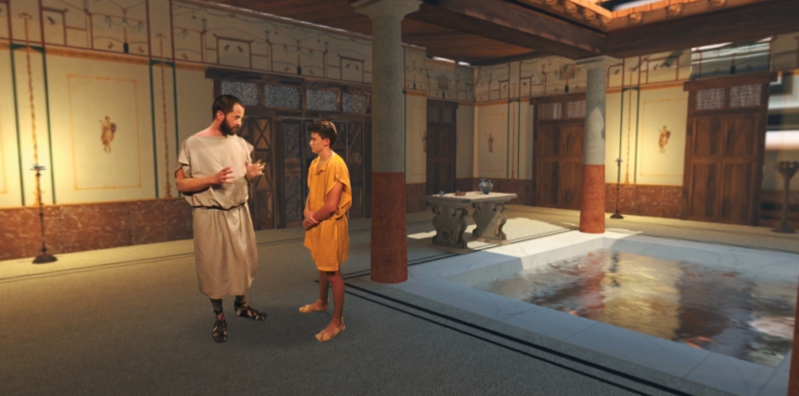

H2020 iMARECulture, 2016-2019
Advanced VR, iMmersive serious games and Augmented REality as tools to raise awareness and access to European underwater CULTURal heritagE
Virtual presentation of underwater cultural heritage
Sarajevo Graphics Group - storytelling

Slide 6
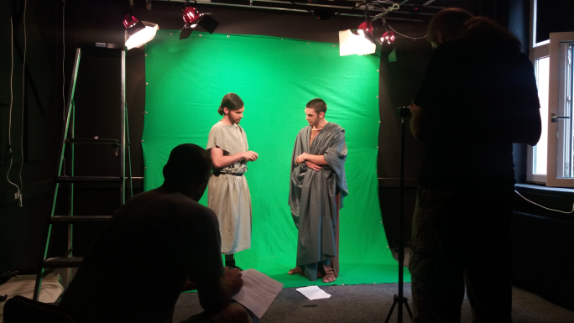
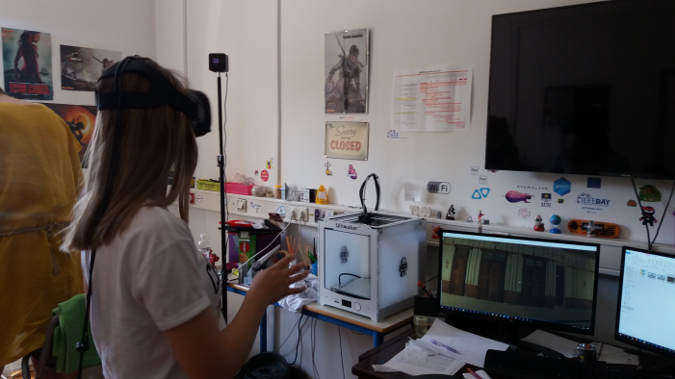
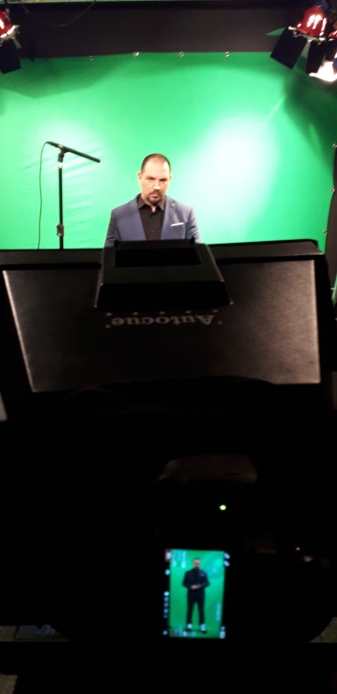
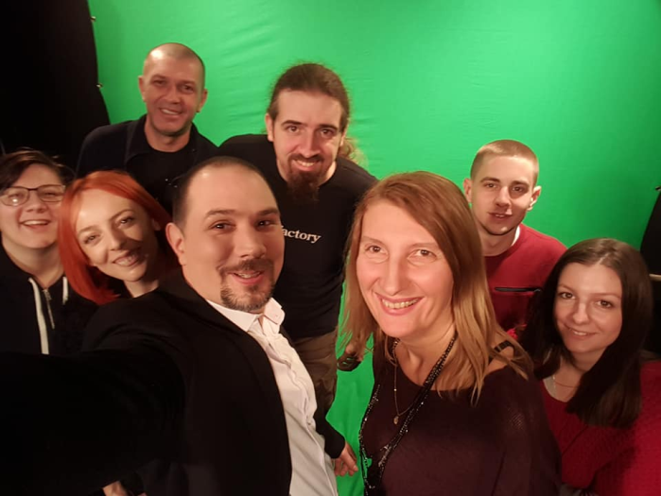
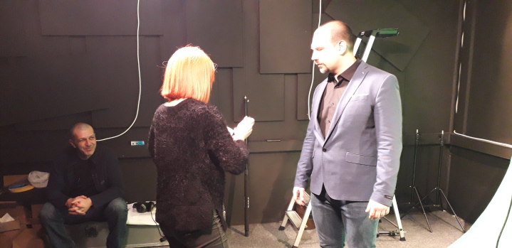
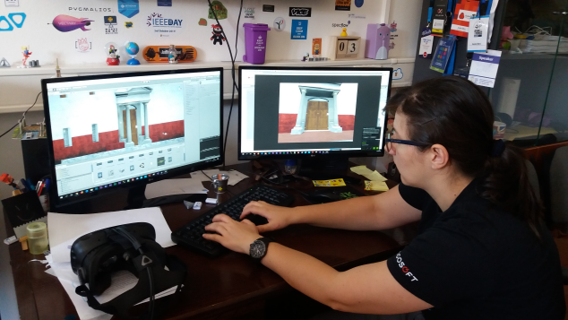
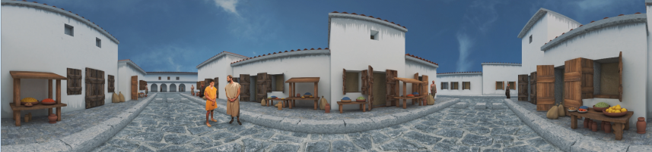
VR interactive digital storytelling
VR stories communicate with user through immersion
Challenge: Film rules cannot be applied to VR video as user is free to look in all directions.

Slide 7
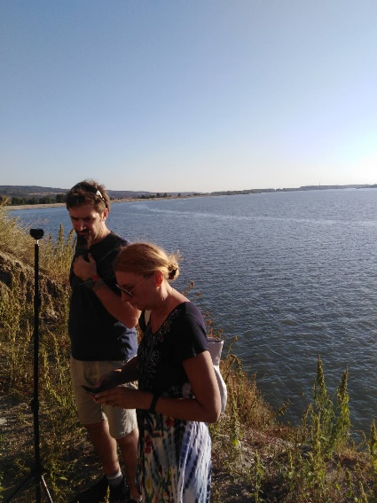
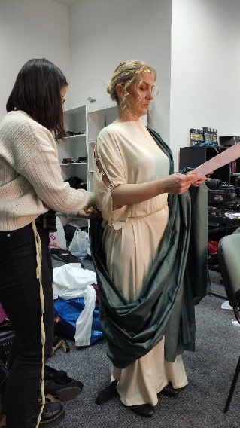
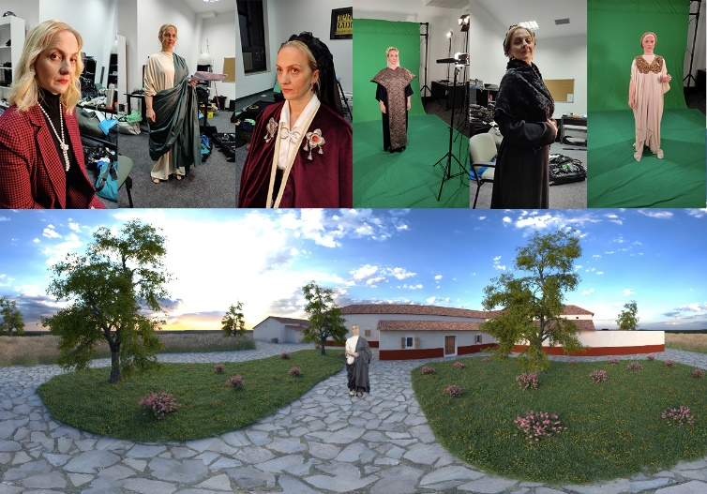
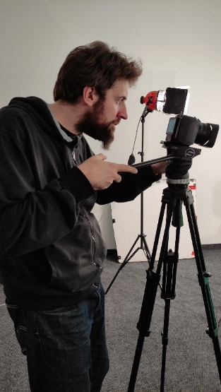
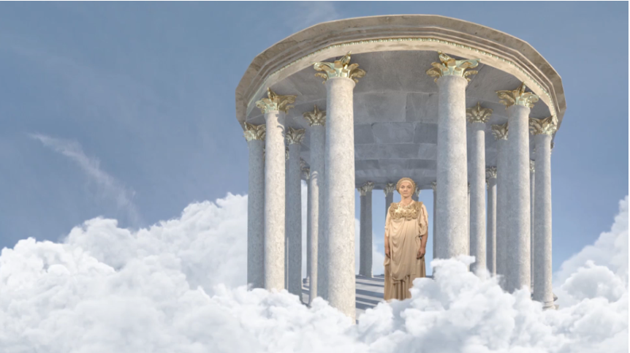
Steps in making of VR application
Collecting information
Writing of scenario
Preparation of costumes and props
Filming of 360 videos
Filming of actors on the location
Photogrammetry of artifacts
Filming of actors on chroma key
Stiching of 360 videos
Editing and compositing
3D modelling and reconstruction
Photogrammetry – creation of models
Music composing
Programming of the application
Testing and bug fixing
Finalization of the product

Slide 8
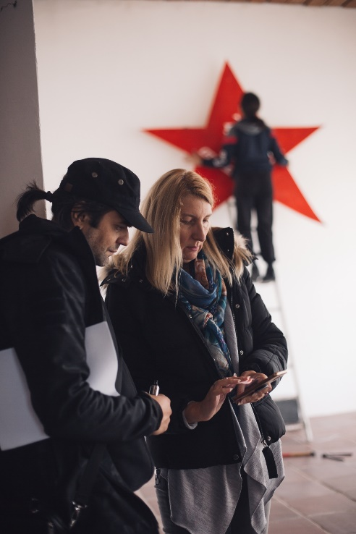
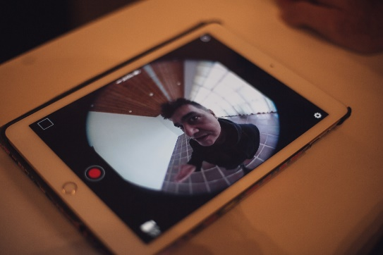
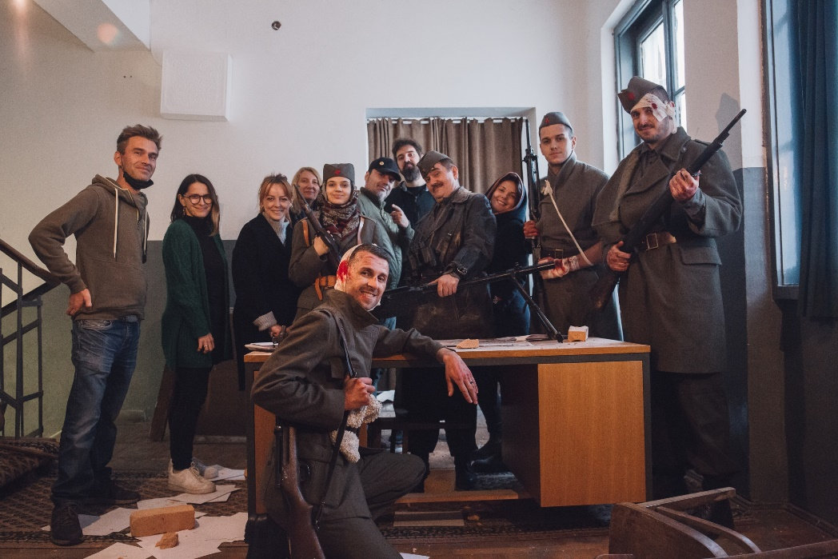
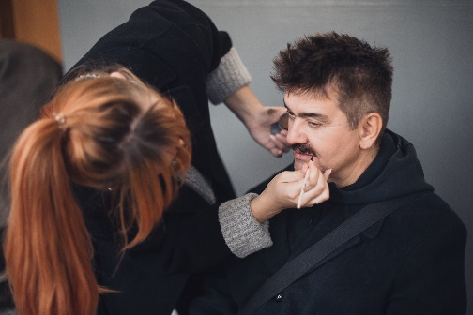
Battle of Neretva VR
One of the most important battles of II World War in Balkans
In collaboration with museum of Jablanica
User has a chance to become a member of resistance and meet Tito

Slide 9
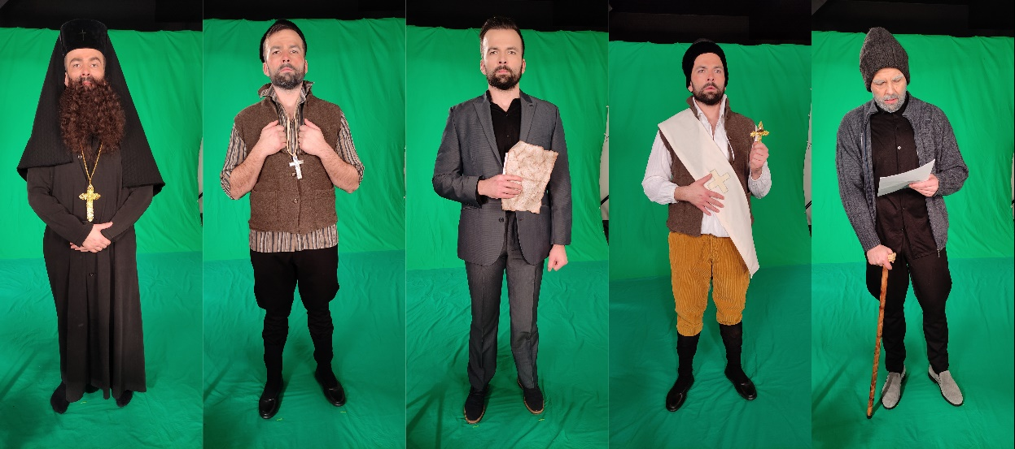
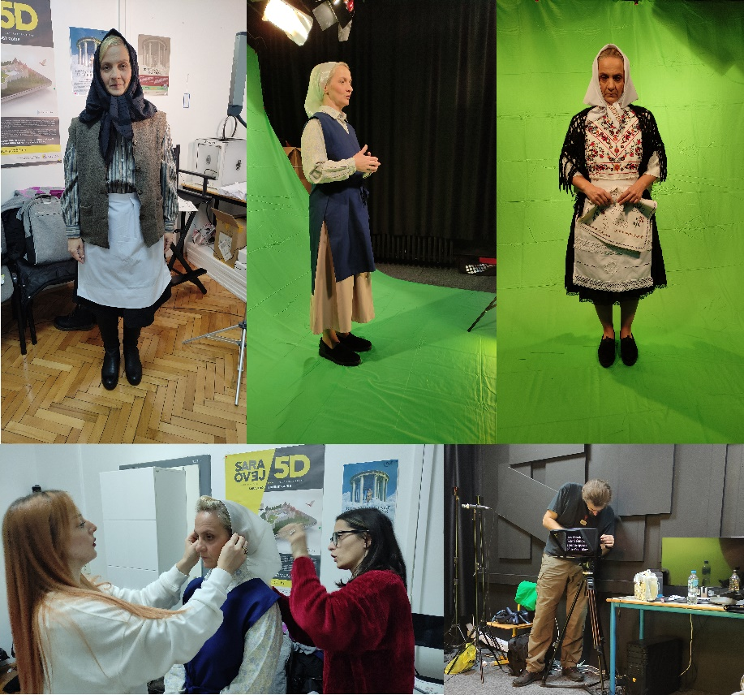
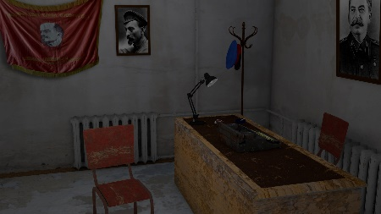
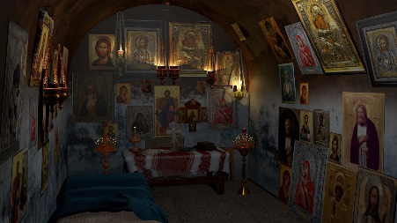
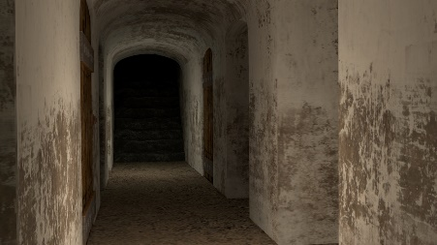
Underground – in progress
Digitalization of exhibition - Hidden Galleries
Torture of Orthodox believers in the former Soviet Union
Desktop VR
8 stories

Slide 10
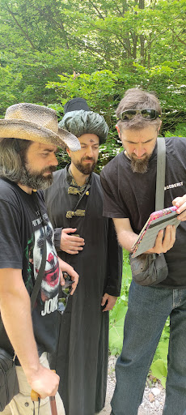
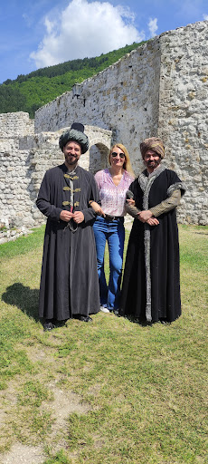
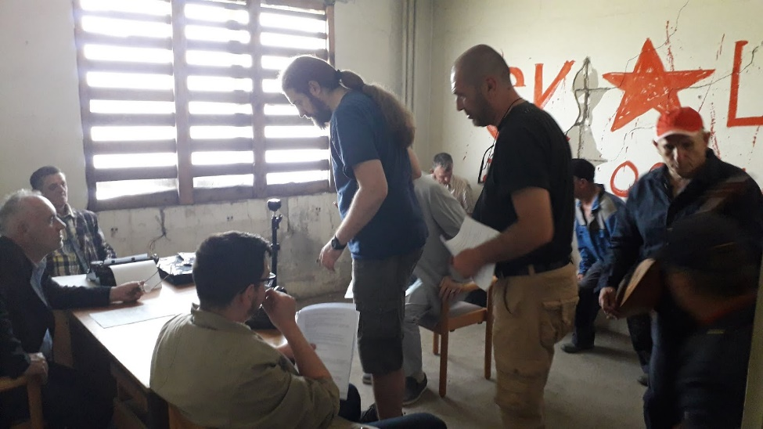
VR films
Nine dissidents
Ilhamija – prvi bosanski disident
First BH VR films
Challenges of 360 video filming

Slide 11
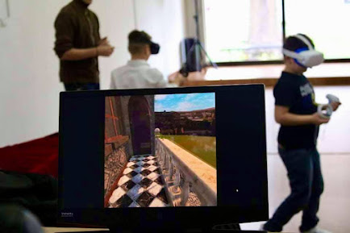
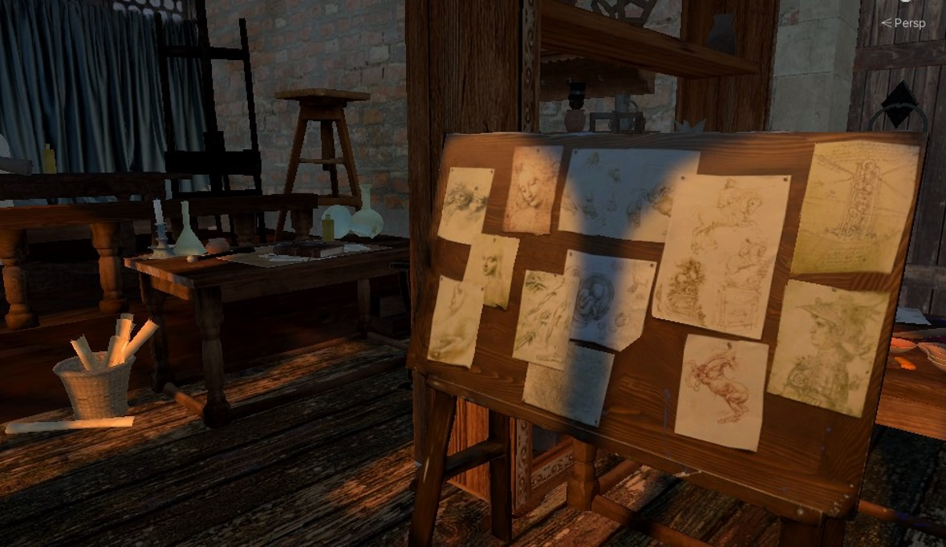
Da Vinci Effect
Creative Europe Real Heroes project
Multiplayer VR application
About Leonardo da Vinci
Searching for Da Vinci inventions in his workshop

Slide 12
Thank you!
www.digi.ba

